Slide 1
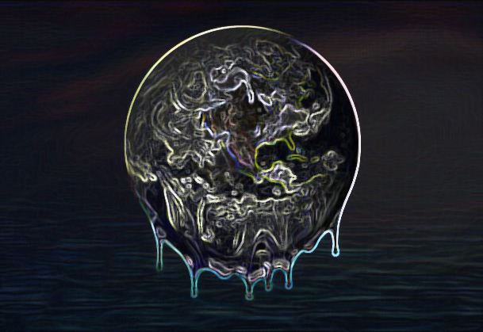
Global Warming

Slide 2
Global Warming:
A Study of Calamitous Climate Trends,
Impact, and Hope
Rutgers Data Science Boot Camp, May 2019
Authors: Deepali Khaparde, Kimberly Andersen, Raghi Ramachandran, Richa Prakash

Slide 3
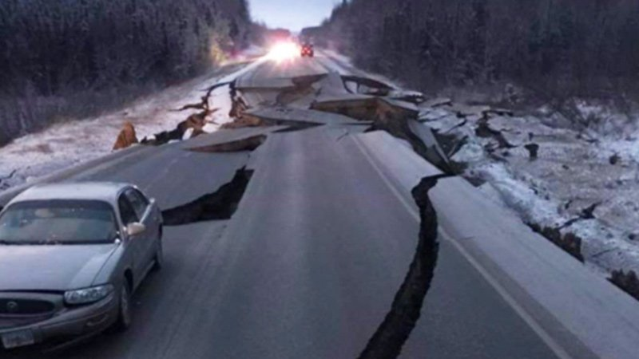
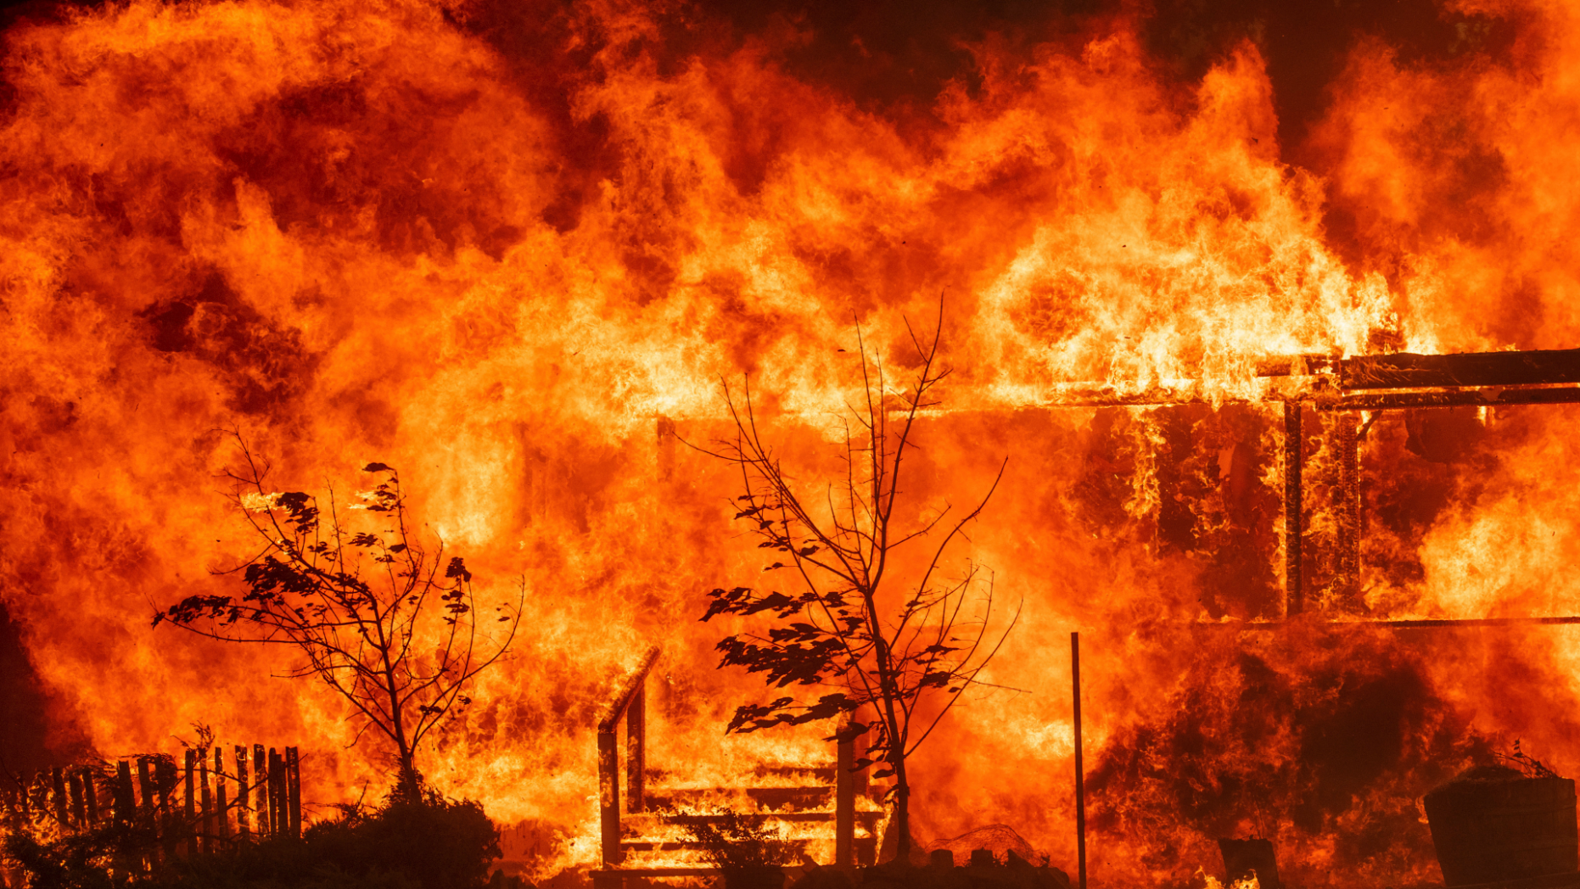
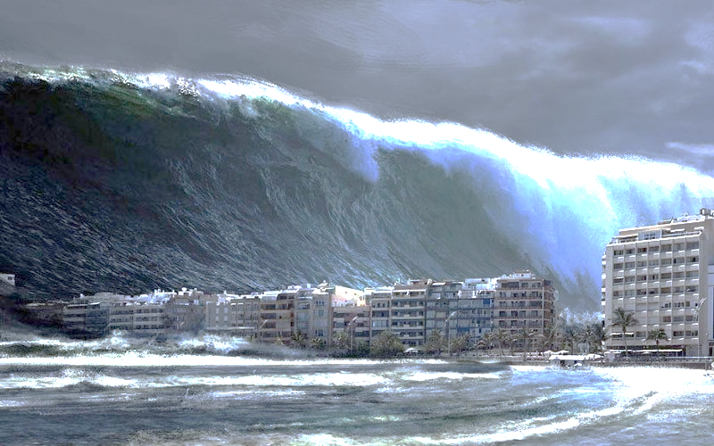
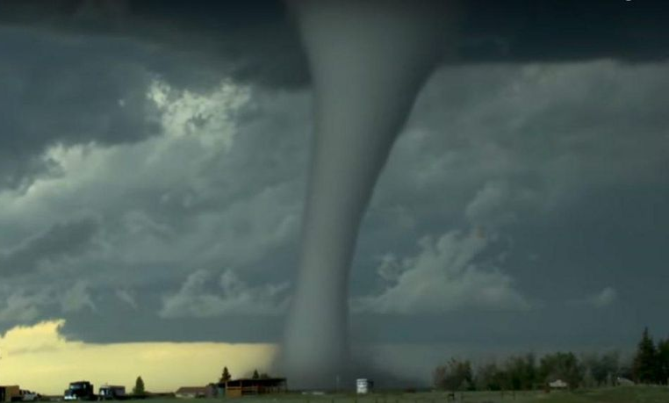
The Devastation of our Planet

Slide 4
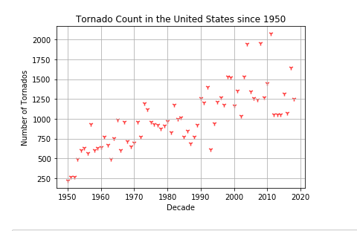
Our first chart shows an massive increase in the number of tornados in the last fifty years, from 250 in 1950 to over 2,000 in 2010

Slide 5
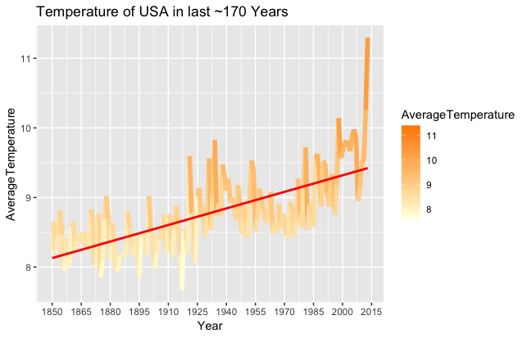
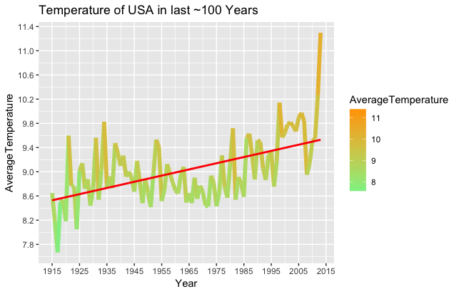
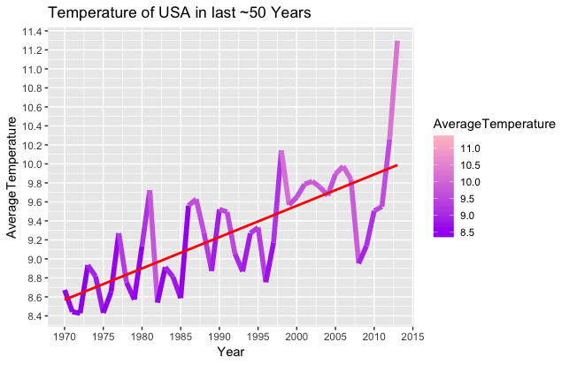
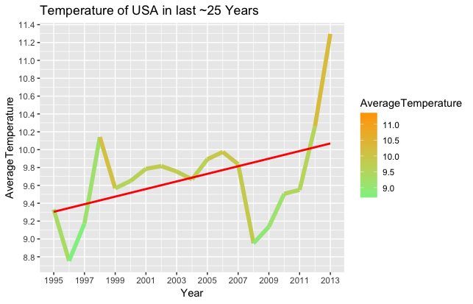
Changes in Temperature
Temperature Visualizations for the USA

Slide 6
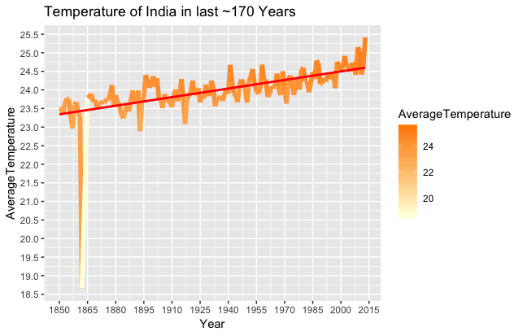
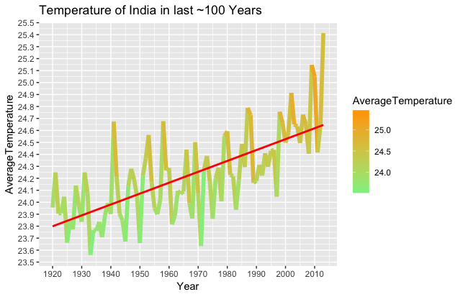
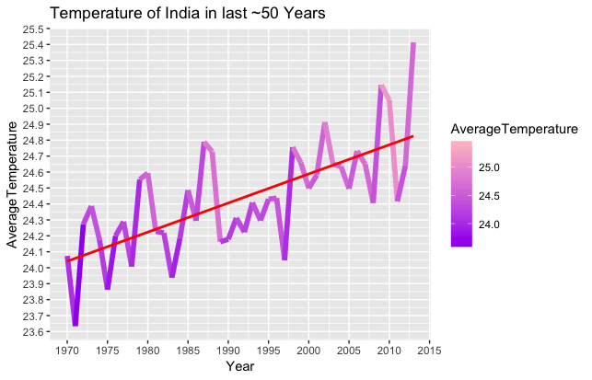
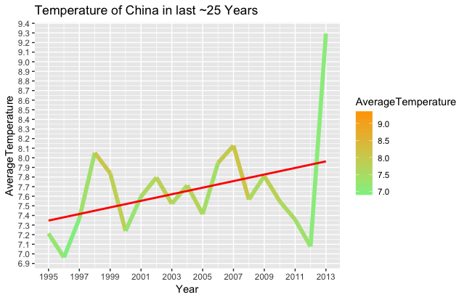
Temperature Visualizations for India

Slide 7
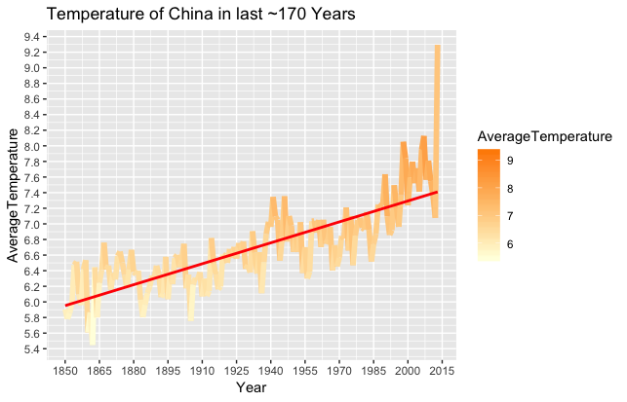
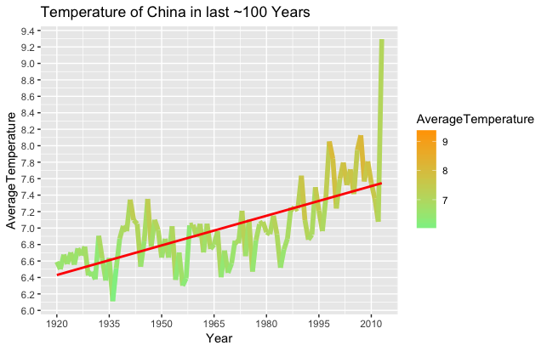
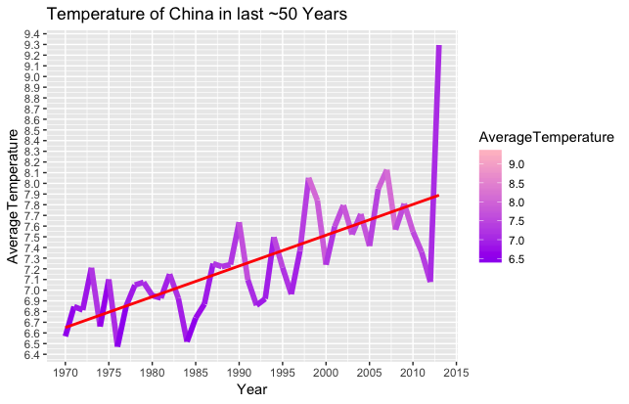
Temperature Visualizations for China

Slide 8
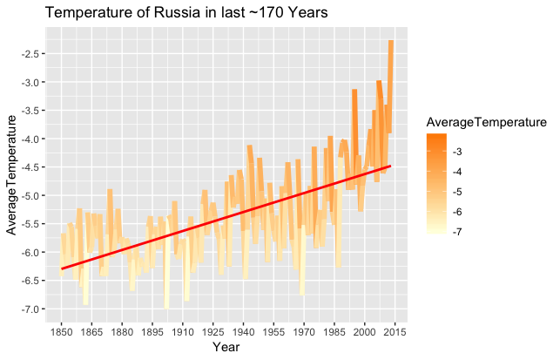
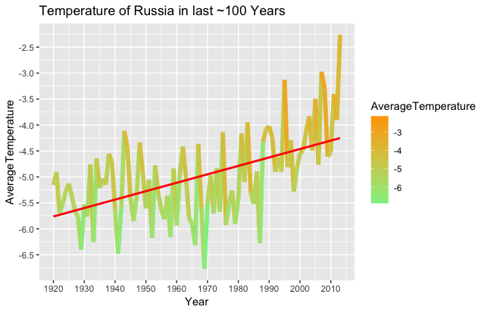
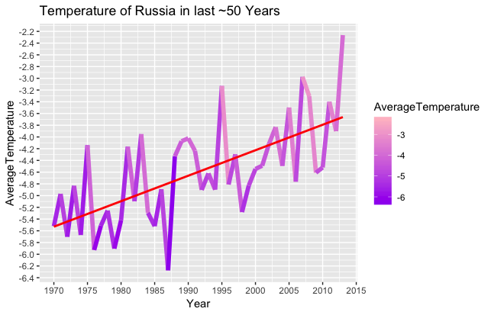
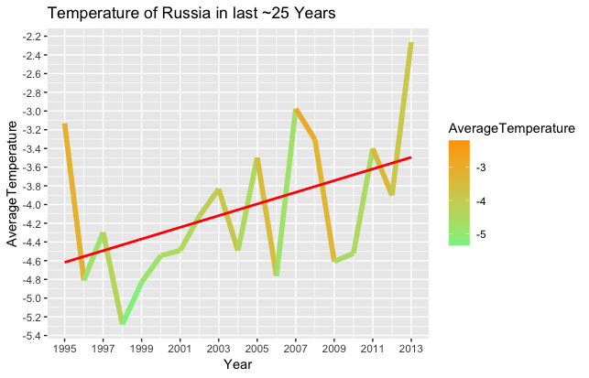
Temperature Visualizations for Russia

Slide 9
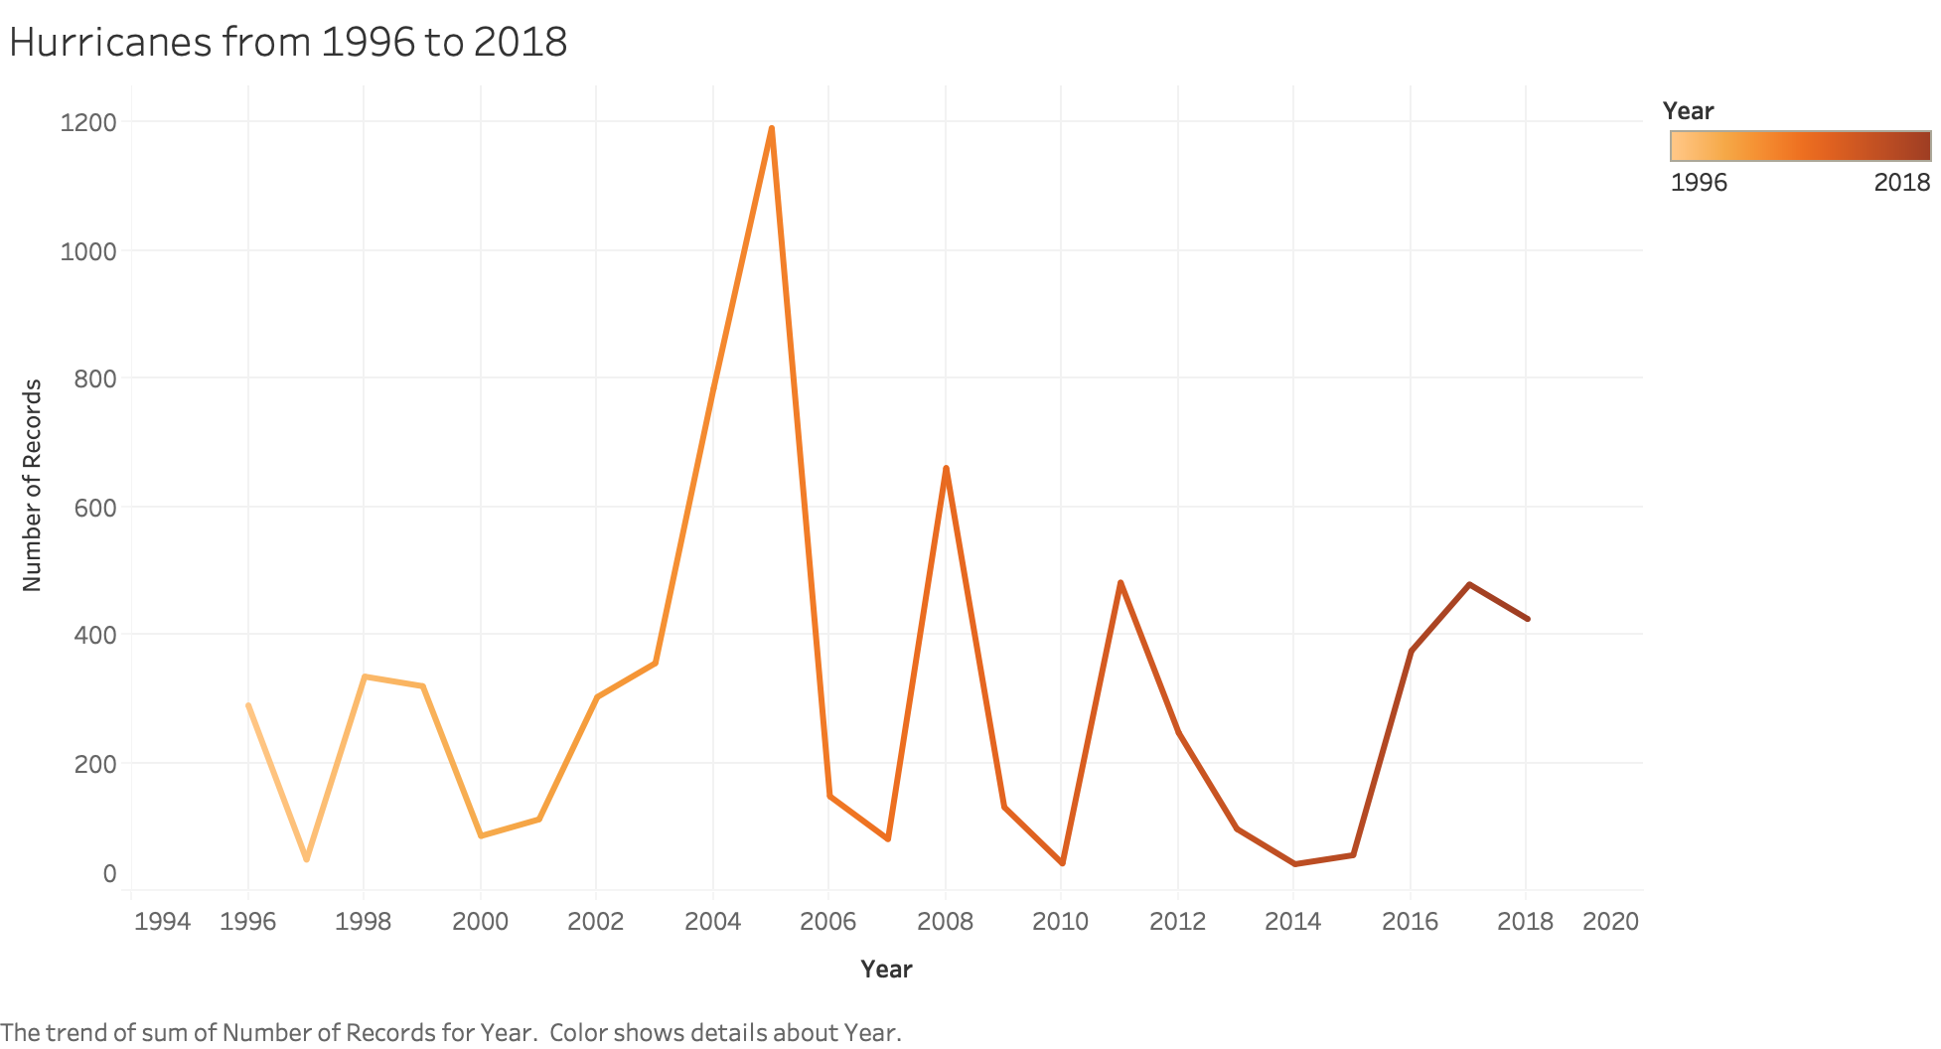

Slide 10
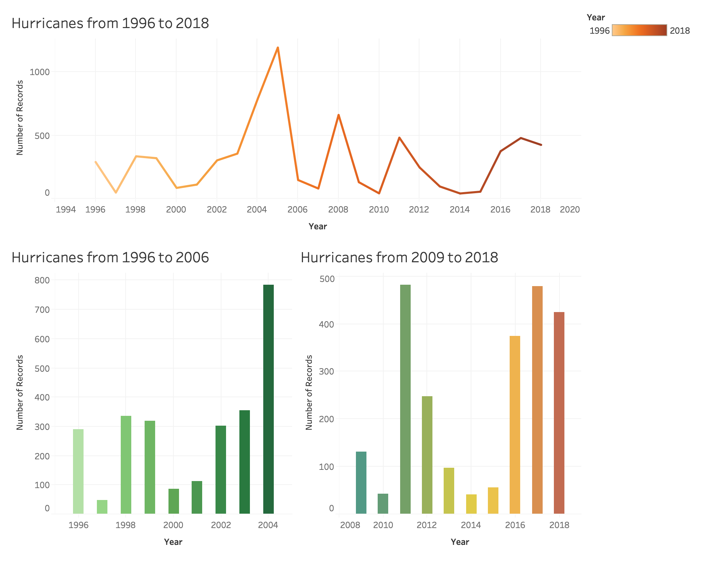

Slide 11
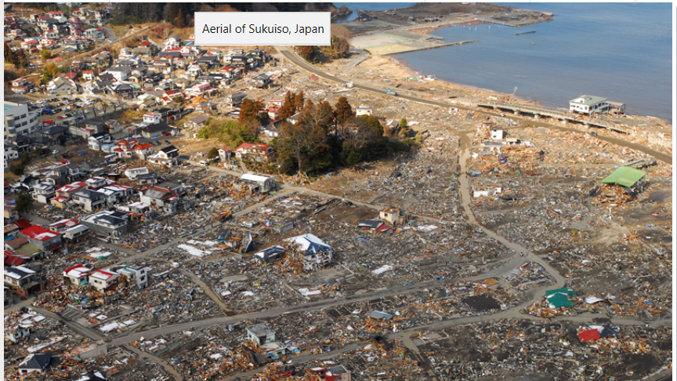

Slide 12
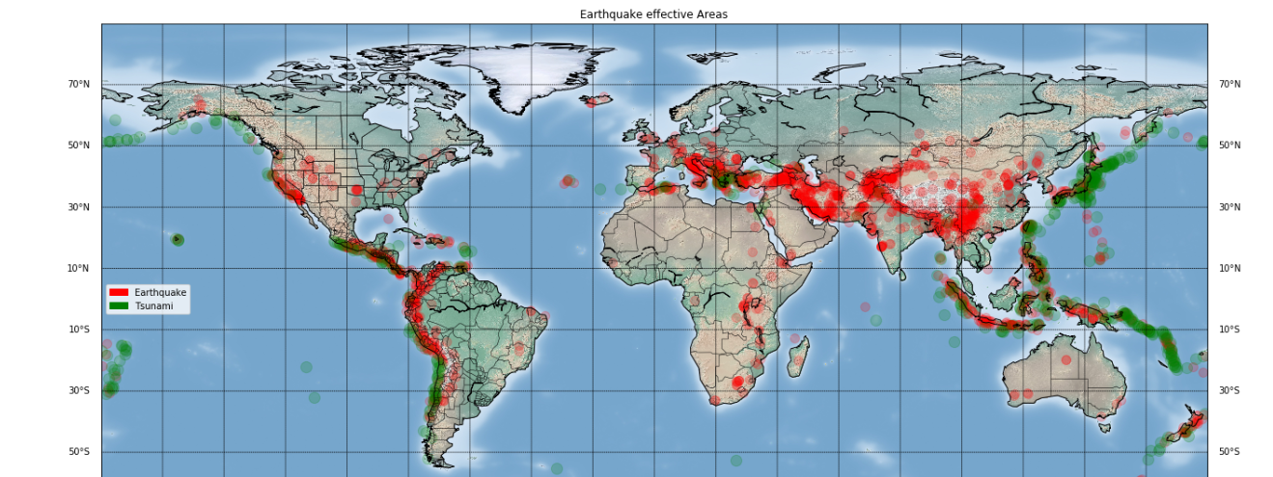
Earthquakes & Tsunamis
Earthquakes Effected Areas Worldwide from 1963 - 2019

Slide 13
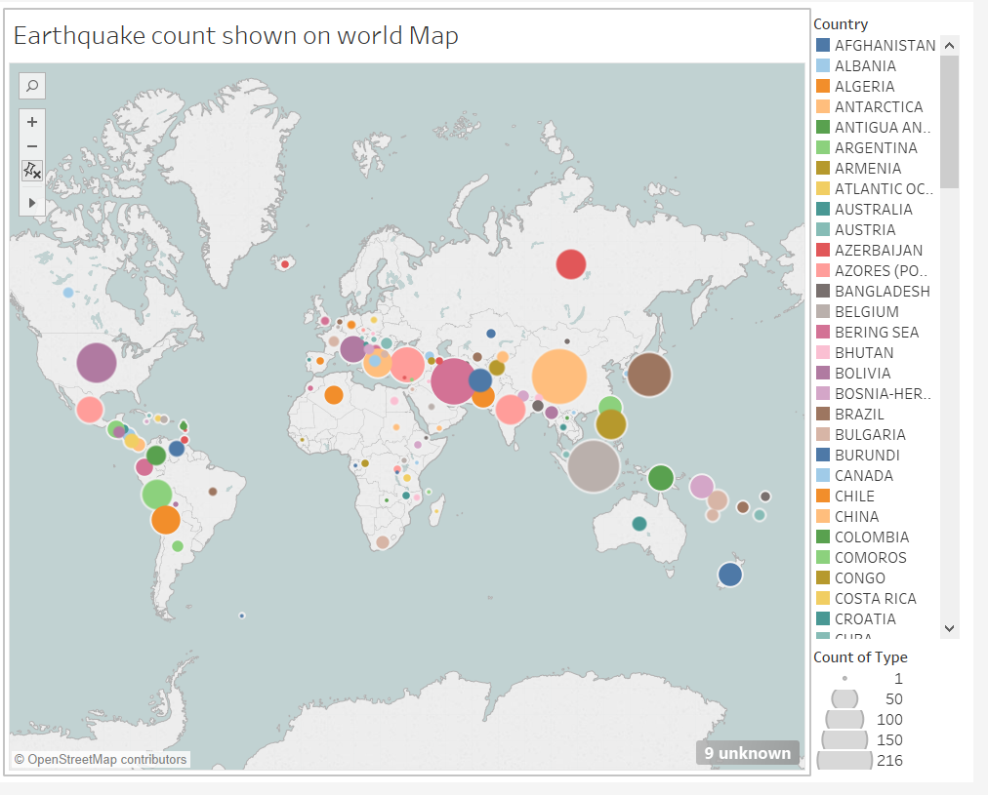
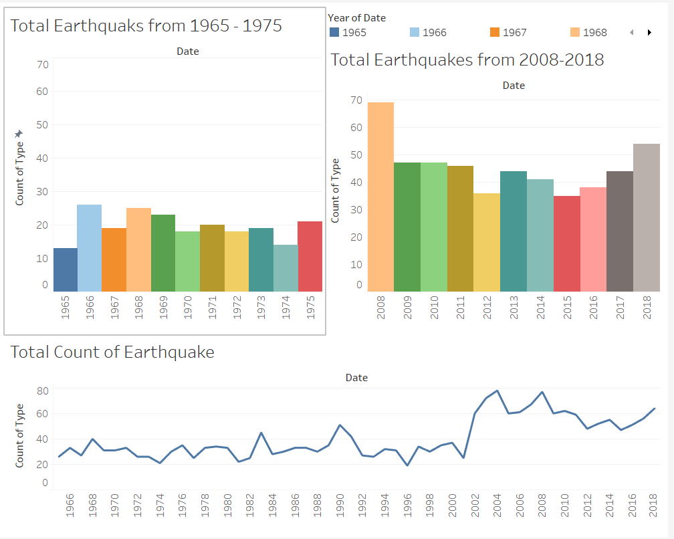
Ten Year Comparison for Earthquakes

Slide 14
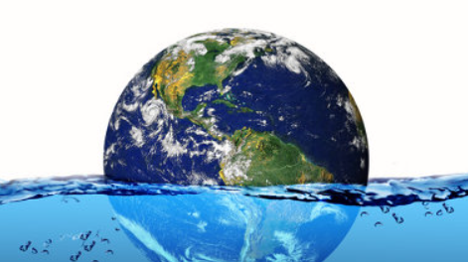
Impacts of Global Warming Rising Sea Level

Slide 15
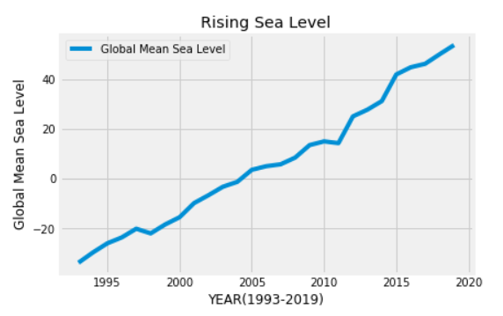
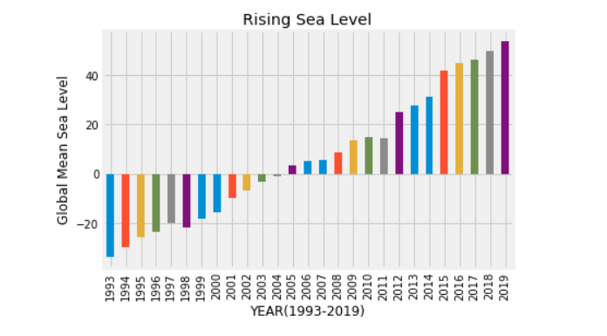
Presentation of Rising Sea Level Data 1993 - 2019

Slide 16
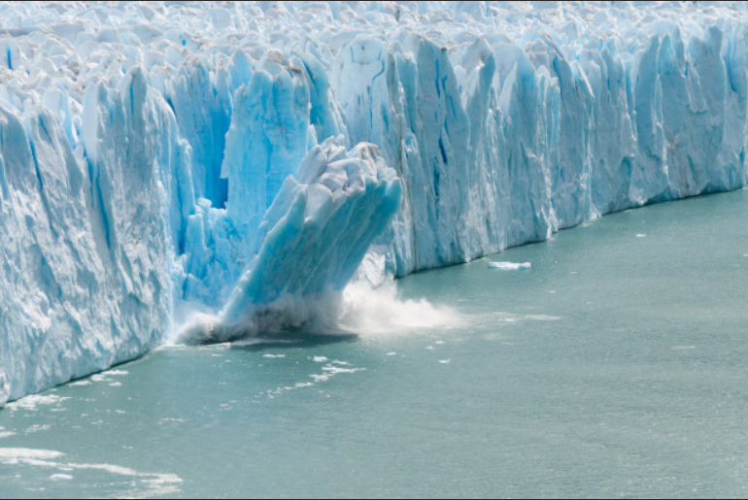
Factors for Rise In Sea Level Melting Glaciers Thermal Expansion

Slide 17
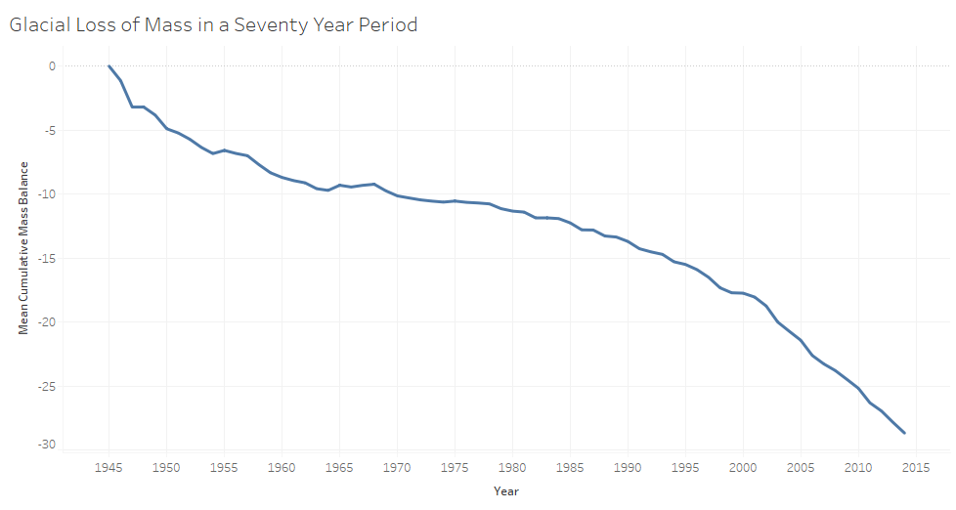
Glaciers: Rapidly Losing Mass and Collapsing Into the Sea

Slide 18
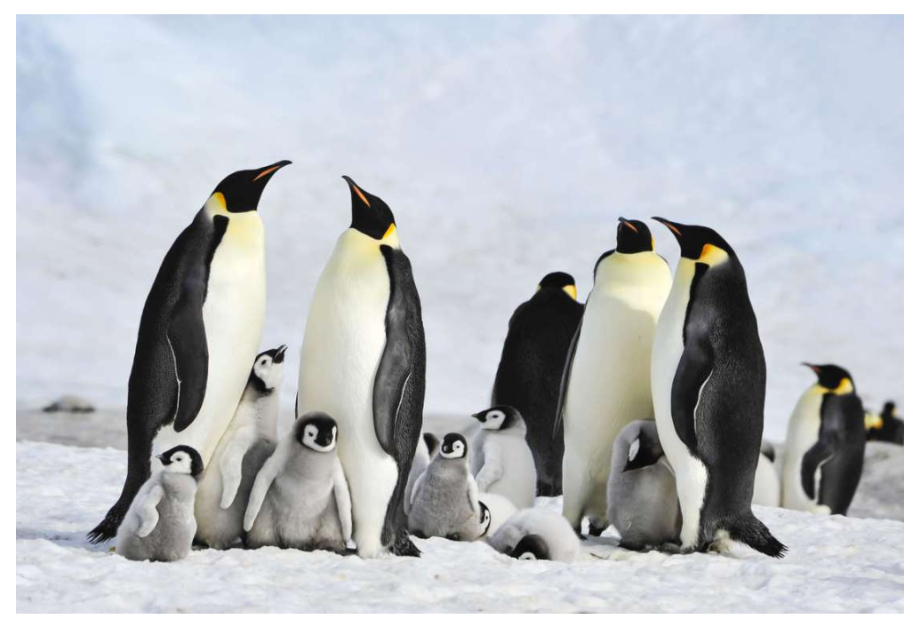
One Of The World’s Largest Penguin Colonies Has Officially Disappeared
Thousands of emperor penguins are presumed dead after an unprecedented sea-ice collapse in the Antarctic — and now, experts are worried there will be more of these incidents as the Antarctic continues to warm.

Slide 19
ML Linear Regression Model
Mean Squared Error (MSE): 0.364
R-squared (R2 ): 0.0

Slide 20
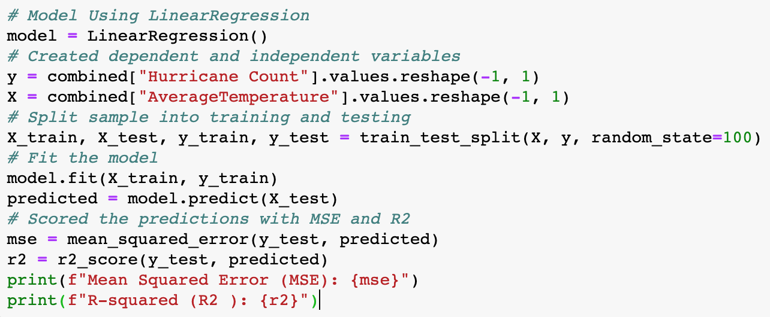
Linear Regression Model

Slide 21
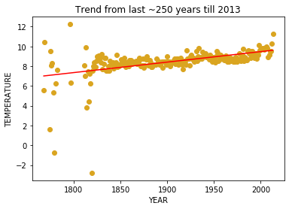
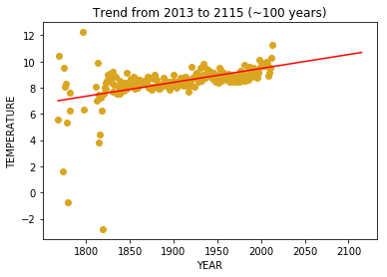
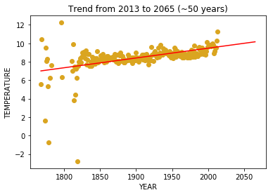
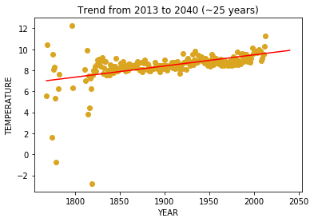
The Linear Regression for Temperature Predictions
Rise in temp from 1768 – 2013 is
~2.6 degree Celsius
Rise in temp from 2013 – 2115 is
~1.1 degree Celsius
Rise in temp from 2013 – 2065 is
~0.6 degree Celsius
Rise in temp from 2013 – 2040 is
~0.3 degree Celsius

Slide 22
Hope:
Steps Being Taken to Ameliorate Global Warming

Slide 23
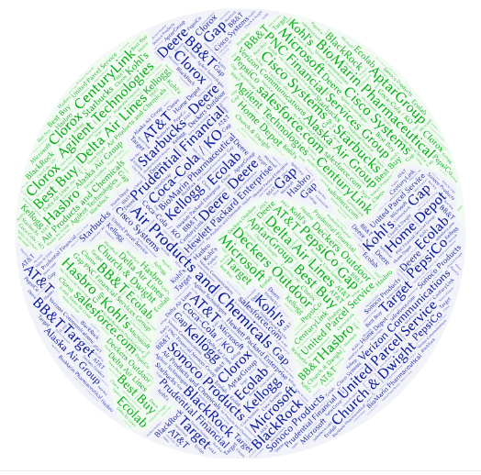
A Small Sampling of Major Corporations Committed to Sustainability

Slide 24
Technologies Utilized:
Python – Pandas – Matplotlib – R – Tableau – Machine Learning
Data Sources:
- NASA
- NOAA
- Kaggle
- NCH (National Hurricane Center)
- Berkeley Earth
- HealthData.gov
Plus: Web Site to Come! Like this one:

Slide 25
